Slide 1
Predicting Student Performance
Unit 3 Capstone Presentation
Heather Dorer
October 30, 2018

Slide 2
The Dataset
PassNYC.org
Mission:
increase the diversity of students taking the Specialized High School Admissions Test (SHSAT), which is a standardized test that many specialized high schools in the NYC area require for admission.
identify underserved and underperforming schools and provide resources to those schools to improve their performance.
1272 K-8 schools in NYC area included in dataset
161 features in dataset:
Location: Lat, Long, Zip
Race percentage breakdown
Performance on English Language and Math assessments per grade, per race
Notes:
The dataset was made available by PASSNYC. From the passnyc.org website PASSNYC is a "not-for-profit, volunteer organization dedicated to broadening educational opportunities for New York City's talented underserved students." As part of their mission, PASSNYC attempts to increase the diversity of students taking the Specialized High School Admissions Test (SHSAT), which is a standardized test that many specialized high schools in the NYC area require for admission. identify underserved and underperforming schools and provide resources to those schools to improve their performance.
In addition to the average student performance on the math and english exams, the dataset includes information such as economic need, student attendance, and how rigorous the instruction is, among others.
The questions that I chose to explore are:
What are the strongest predictors of student academic performance at a given school?
What are the most effective ways to enhance student academic performance?

Slide 3
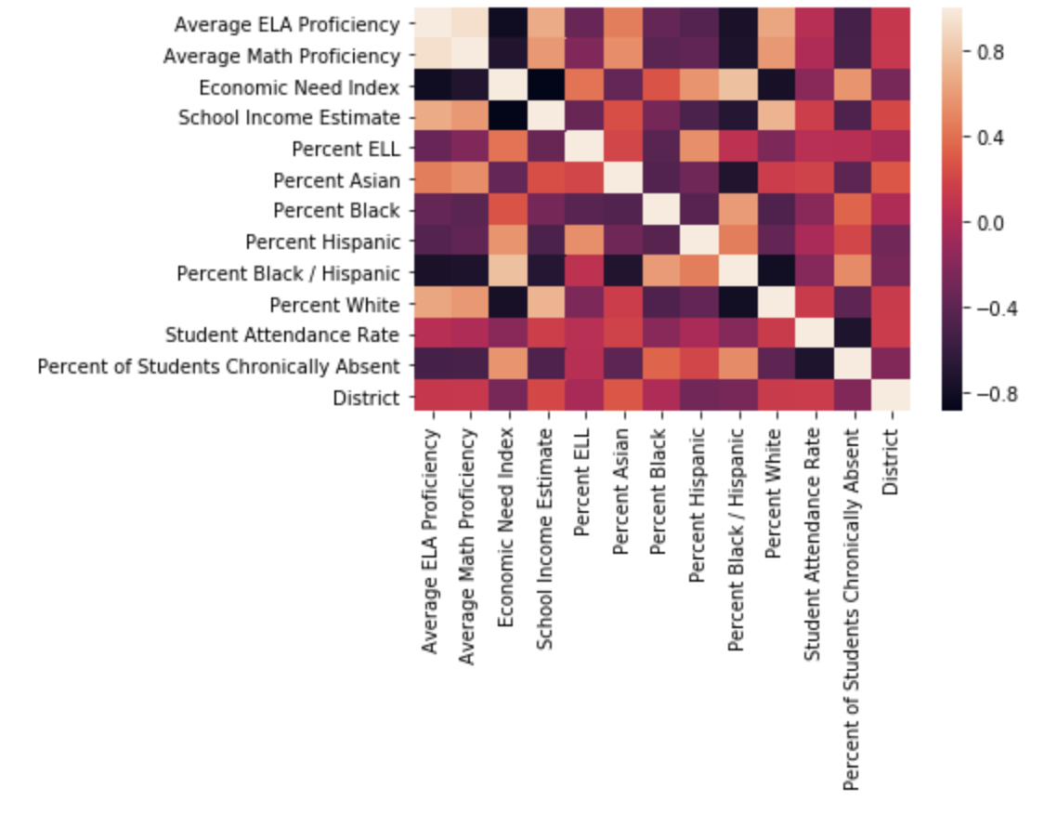
Assessing multicollinearity
'Average ELA Proficiency' and 'Average Math Proficiency’
'Economic Need Index' and 'School Income Estimate’:
'Student Attendance Rate' and 'Percent of Students Chronically Absent’
'District' and Race percentages
'Economic Need Index' and Race Percentages
Notes:
'Average ELA Proficiency' and 'Average Math Proficiency': The 'Average ELA Proficiency' variable had slightly stronger relationships with the other features than the 'Average Math Proficiency' and therefore will be the outcome variable.
2. 'Economic Need Index' and 'School Income Estimate': There is a strong negative correlation of -0.9 between the two features, meaning that as the economic need index increases, the school income estimate decreases. This strong correlation shows that 'Economic Need Index' contains most of the information that could be gleaned from 'School Income Estimate' such that 'School Income Estimate' can be dropped, as it's missing 396 values.
3. 'Student Attendance Rate' and 'Percent of Students Chronically Absent': There is a strong negative correlation of -0.72 between the 'Student Attendance Rate' and 'Percent of Students Chronically Absent', meaning that as the student attendance rate increases, the percent of students chronically absent decreases. This will present multicollinearity issues and therefore one variable should be dropped for linear regression models. As the 'Percent of Students Chronically Absent' has a much stronger relationship with both outcome variable, the 'Student Attendance Rate' will be dropped for linear and logistic regression models.
4. 'District' and Race percentages: There appears to be only weak correlations between 'District' and race percentages and therefore the variable 'District' should not be dropped.
Race percentages: The strongest relationship between the race percentages is a -0.79 correlation between 'Percent Black/Hispanic' and 'Percent White', meaning that as the percentage of black/hispanic students increases, the percentage of white students decreases.
5. 'Economic Need Index' and Race Percentages: Two strong relationships exist between economic need and race percentages, which is a 0.78 correlation between economic need and 'Percent Black/Hispanic', meaning that as the percentage of black/hispanic students increases, so does the economic need. The other is a -0.77 correlation between economic need and 'Percent White', meaning that as the percentage of white students increases, the economic need decreases.

Slide 4
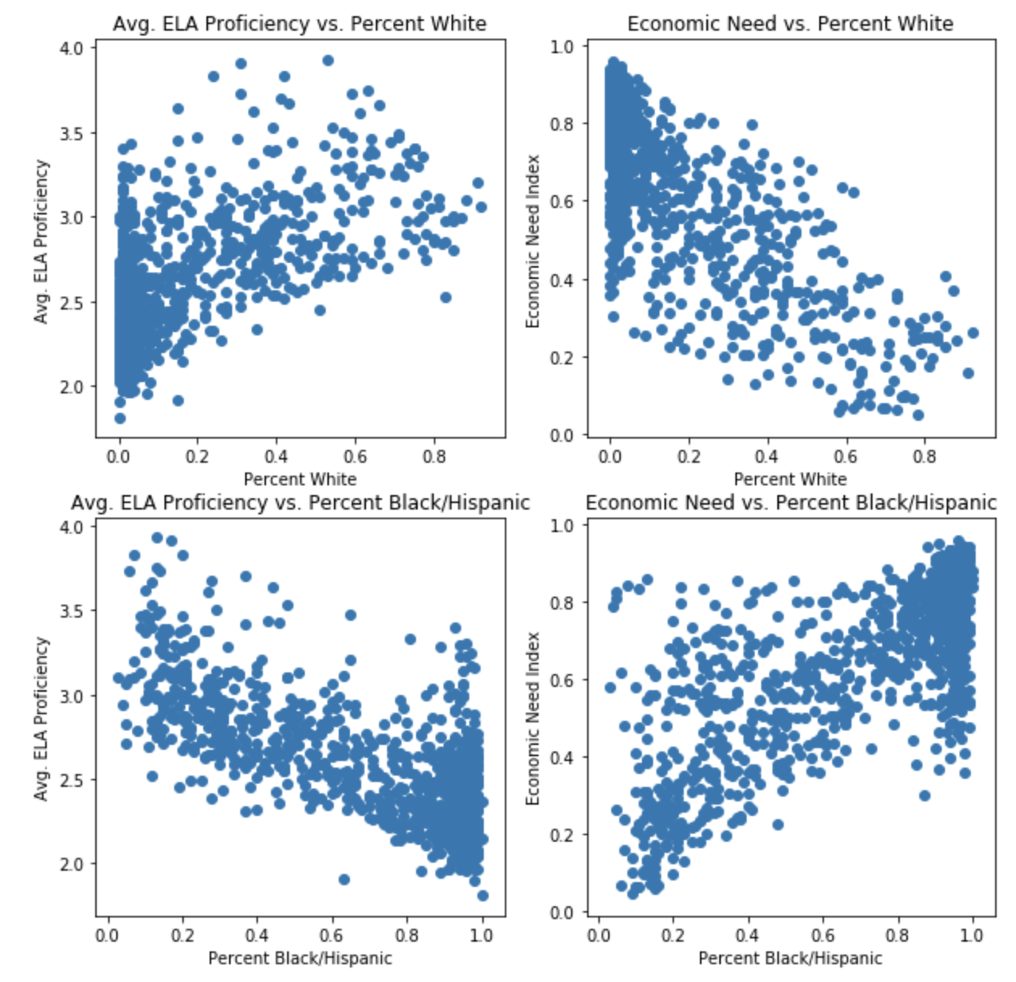
academic performance vs. Race percentages
As the percentage of white students increases, the economic need decreases and the average ELA proficiency increases
Beyond these two strong trends, however, the correlations between race percentages and average ELA proficiency for other races was much weaker.
Notes:
The plots above show that as the percentage of white students increases, the economic need decreases and the average ELA proficiency increases. Conversely, when the percentage of black/hispanic students increases, the economic need increses and the average ELA proficiency decreases. Beyond these two strong trends, however, the correlations between race percentages and average ELA proficiency for other races was much weaker.
Given the strong correlation between economic need and academic performance, and the weaker correlations between race percentages and academic performance, it is my hypothesis that student academic performance is product of economic need as opposed to race, and that any apparent relationship between race percentage and academic performance is due to a relationship between race distribution and economic distribution.

Slide 5
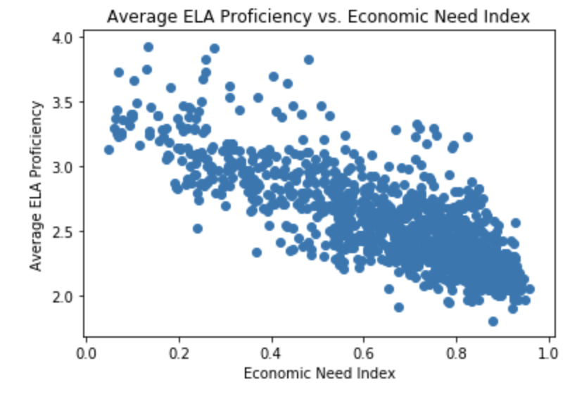
Academic performance vs. economic need
As economic need increased, academic performance decreased
Notes:
Possible reasons for the strong relationship between economic need and academic performance may be related to the fact that schools with a greater economic need:
Don't have the funding for specialized teaching programs, such as special education programs or English as a second language (ESL) programs.
Don't have the funding for arts or sports programs, which can teach critical thinking skills.
Don't have the funding to hire adequate numbers of teachers or build enough classrooms, meaning that there are high student-teacher ratios, such that the teachers cannot give the students the necessary feedback to enhance their learning.
Are located in poorer areas (as property taxes often fund local schools), meaning that the students' ability to learn may be hindered by outside influences such as hunger or sleep deprivation.
What this data cannot explain is why this racial and economic distribution exists, however, that is beyond the scope of this analysis. Given the arguments above, I will be excluding race information from all of my models.

Slide 6
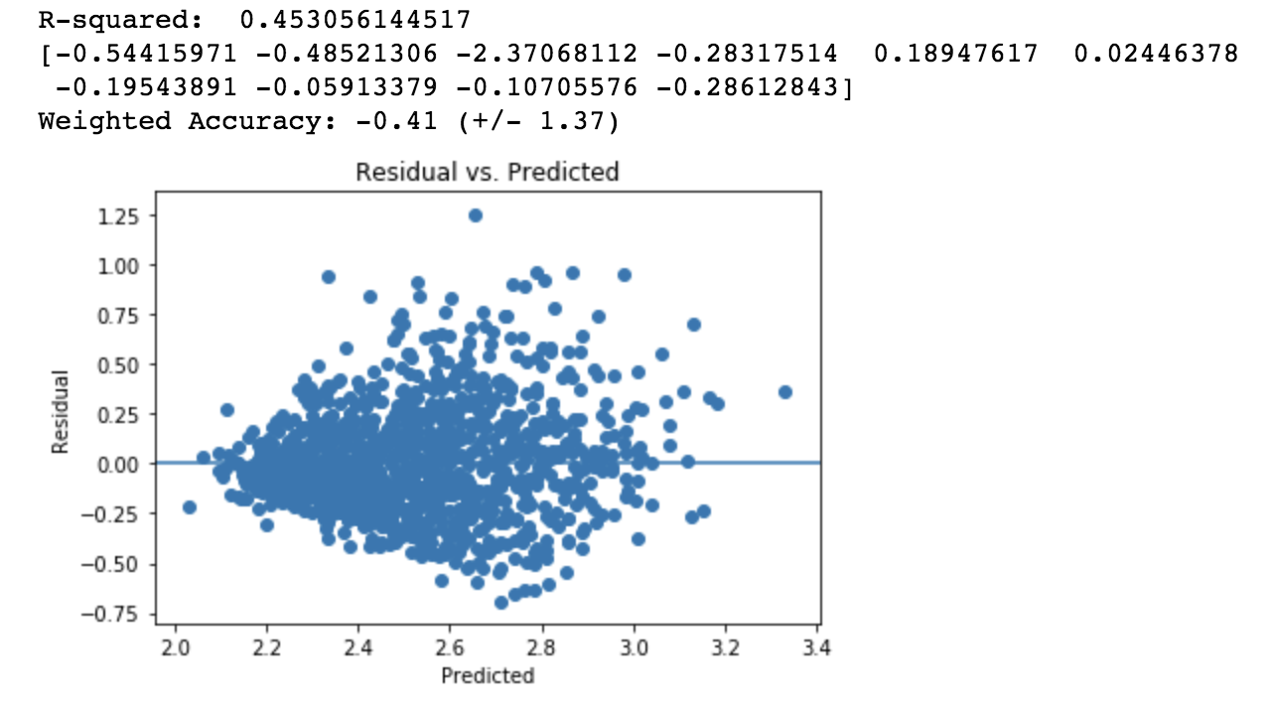
Weighted Knn regression

Slide 7
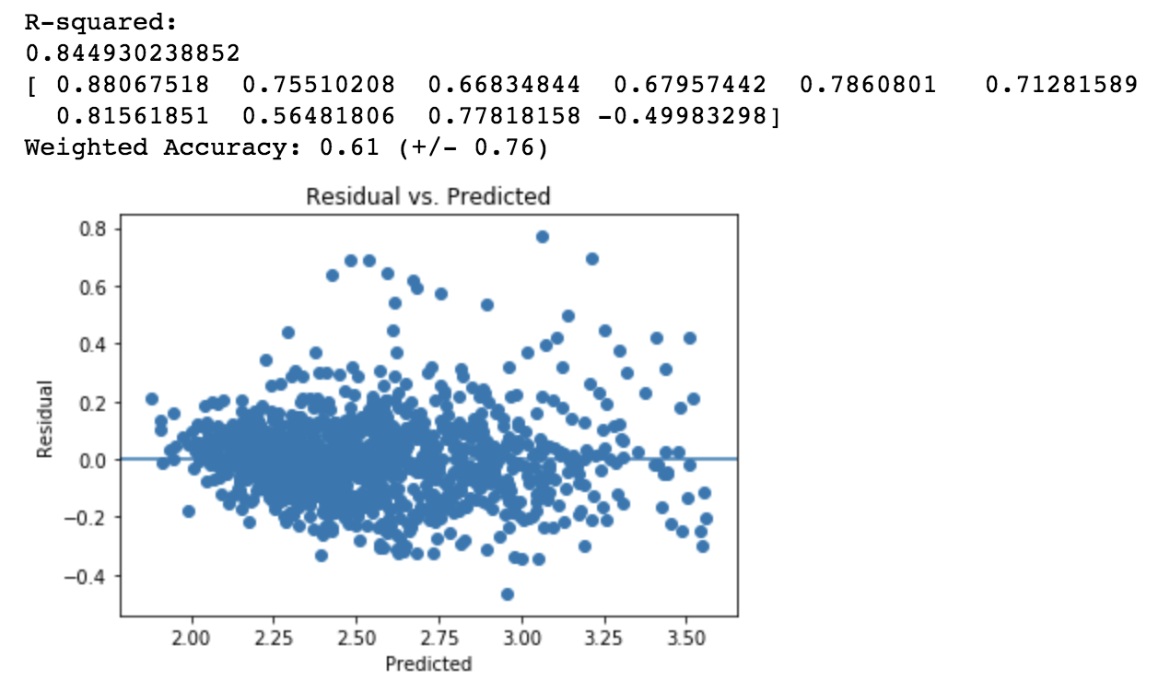
Linear regression

Slide 8
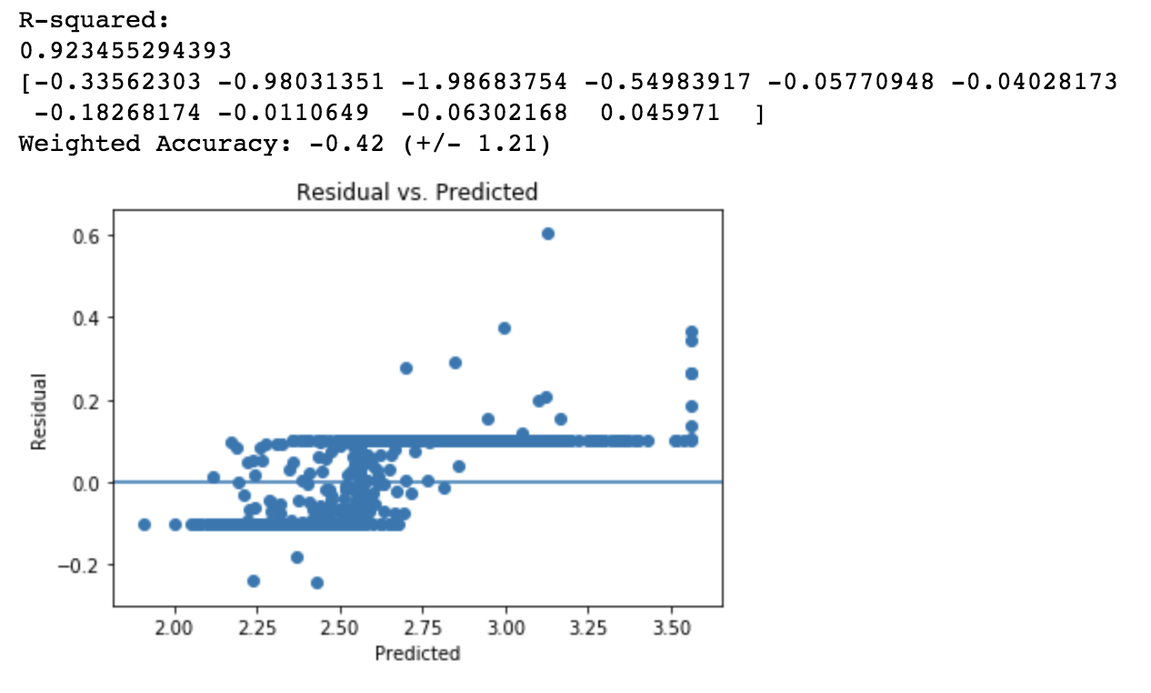
Support vector machines

Slide 9
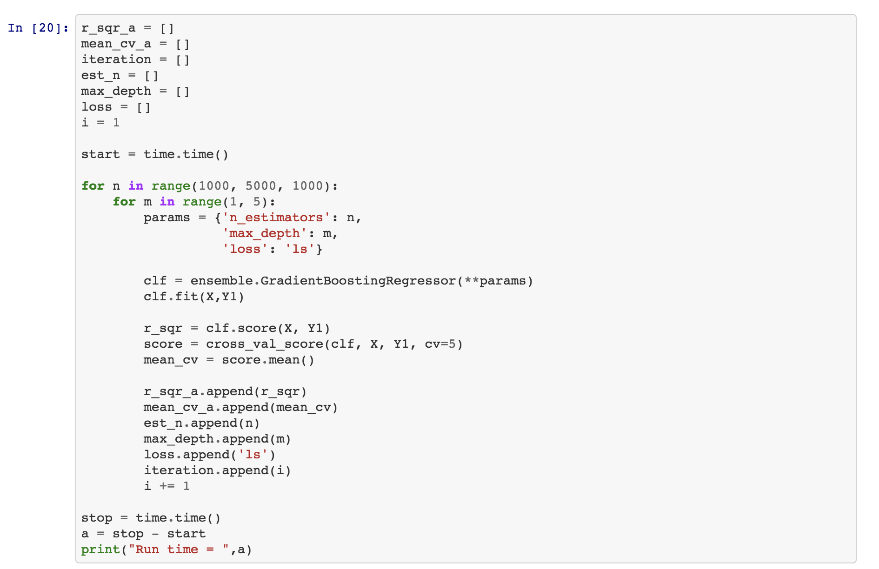
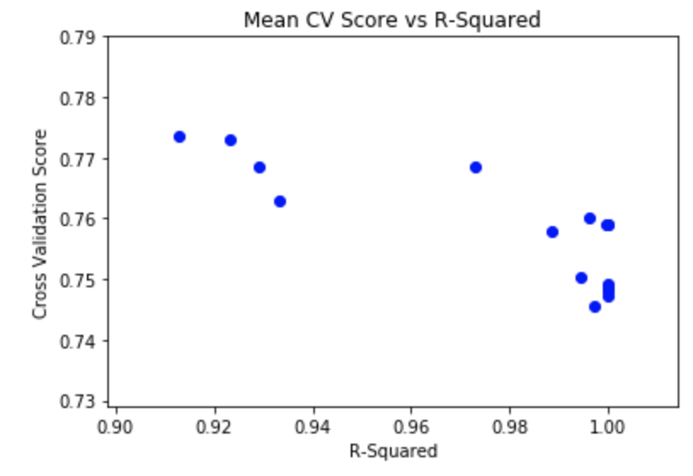
Gradient boosting regressor

Slide 10
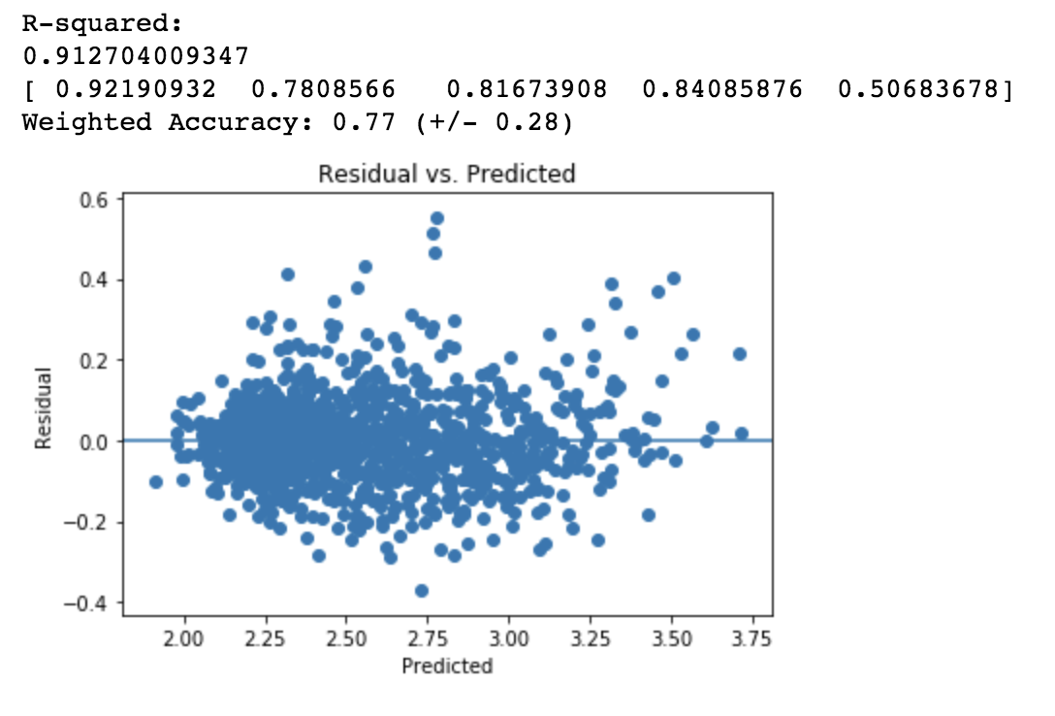
Gradient boosting regressor

Slide 11
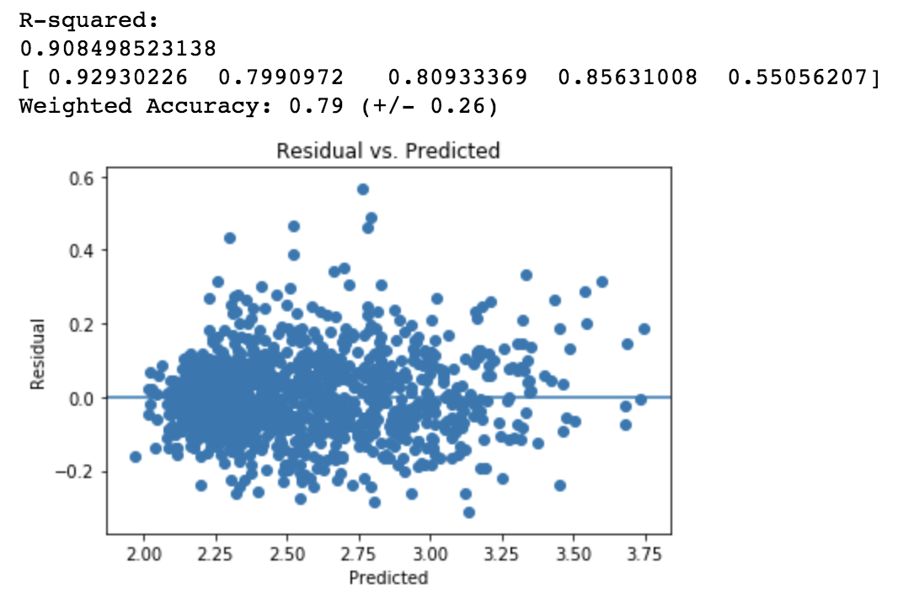
Gradient boosting regressor - gridsearchcv

Slide 12
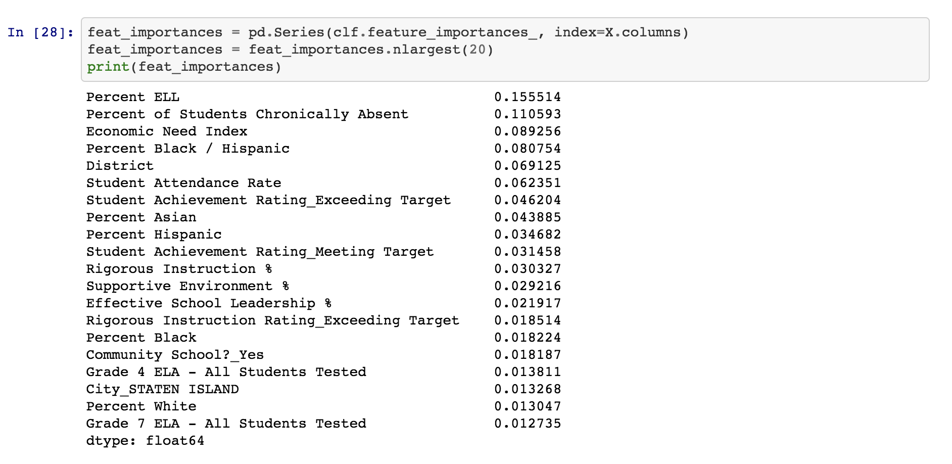
Feature importance

Slide 13
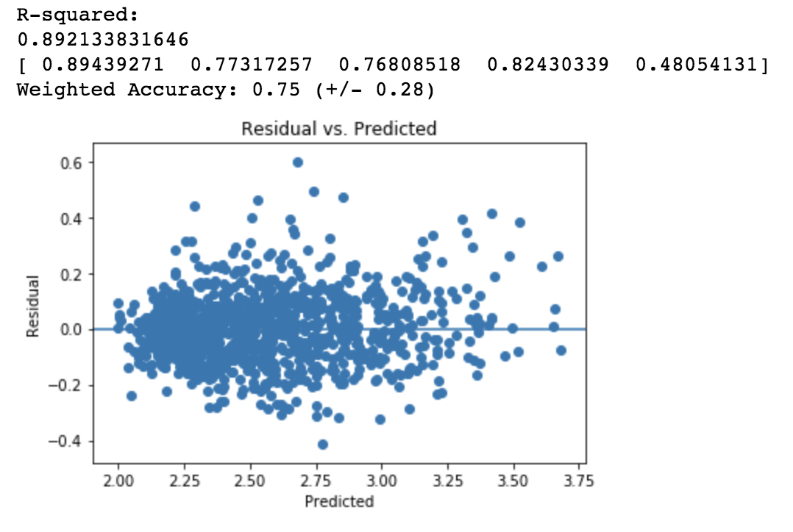
Gradient boosting regressor – top 20 params

Slide 14
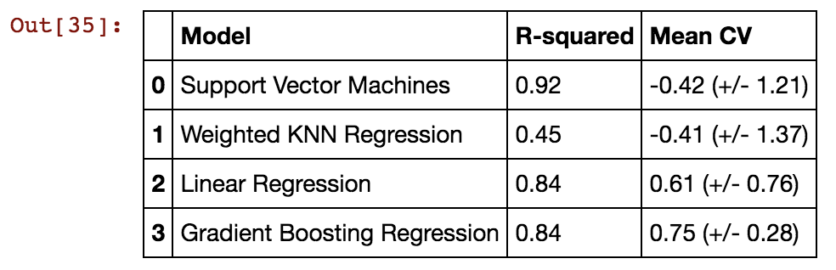
Model comparison

Slide 15
Thank you
Questions?

